Slide 1
Network Namespace and Ethernet Bridge
Sandip Chakraborty
Rajat Subhra Chakraborty

Slide 2
What is a namespace?
In computing, a namespace is a set of signs (or names) used to uniquely identify or refer objects of various kinds. (Source: Wikipedia)
Linux namespace
Partition kernel resources
One set of processes observes one set of resources, while another set of processes observes a different set of resources
Hardware Resources

Slide 3
What is a namespace?
In computing, a namespace is a set of signs (or names) used to uniquely identify or refer objects of various kinds. (Source: Wikipedia)
Linux namespace
Partition kernel resources
One set of processes observes one set of resources, while another set of processes observes a different set of resources
Namespace 1
Hardware Resources

Slide 4
What is a namespace?
In computing, a namespace is a set of signs (or names) used to uniquely identify or refer objects of various kinds. (Source: Wikipedia)
Linux namespace
Partition kernel resources
One set of processes observes one set of resources, while another set of processes observes a different set of resources
Namespace 1
Namespace 2
Hardware Resources

Slide 5
What is a namespace?
In computing, a namespace is a set of signs (or names) used to uniquely identify or refer objects of various kinds. (Source: Wikipedia)
Linux namespace
Partition kernel resources
One set of processes observes one set of resources, while another set of processes observes a different set of resources
Are used to provide isolation or sandboxing
Virtualization of kernel resources (Linux containers)

Slide 6
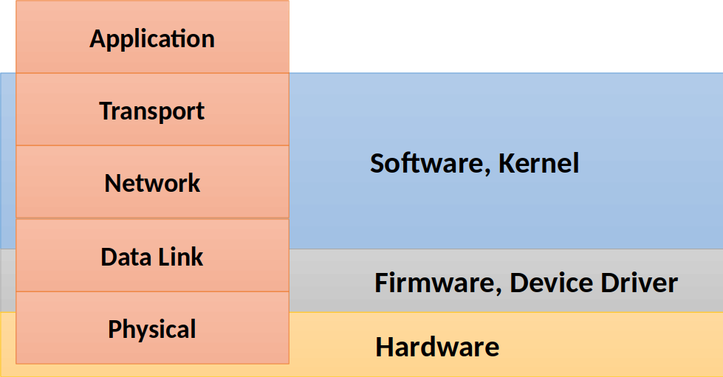
Network Protocol Stack

Slide 7
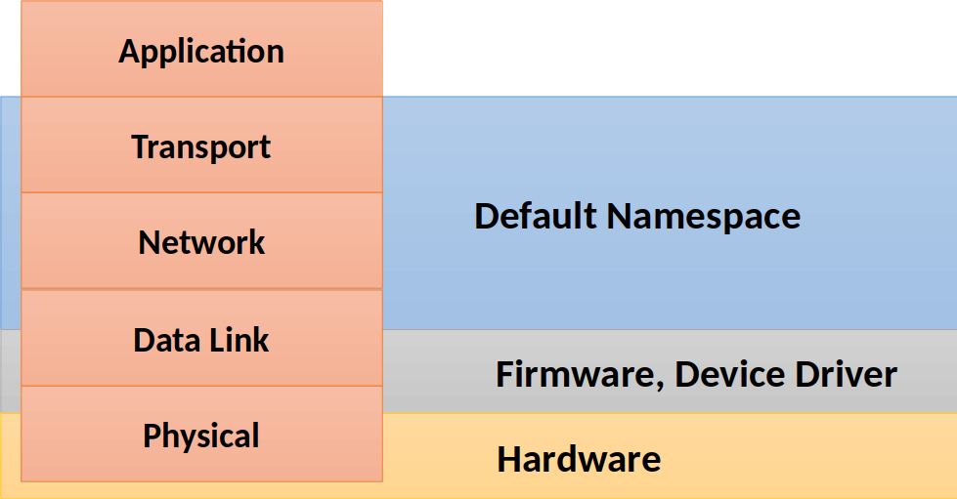
Network Namespace

Slide 8
Network Namespace
Hardware

Slide 9
Network Namespace
Global namespace
Network interface
Routing tables
IP tables
Kernel
Hardware

Slide 10
Network Namespace
Namespace 1
Network interface
Routing tables
IP tables
Namespace 2
Network interface
Routing tables
IP tables
Namespace 3
Network interface
Routing tables
IP tables
Global namespace
Network interface
Routing tables
IP tables
Kernel
Hardware

Slide 11
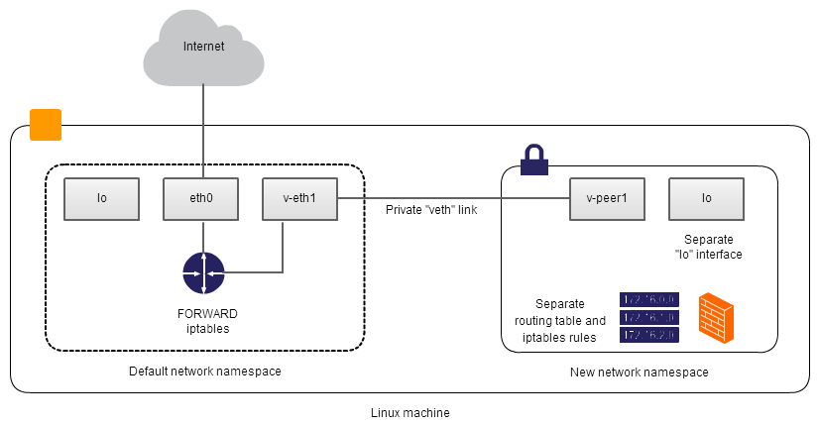
Create a private network using network namespace
Image source: https://blog.famzah.net/2014/06/05/private-networking-per-process-in-linux/

Slide 12
Interconnecting network namespaces through veth interfaces
Namespace ns1
ip netns add ns1

Slide 13
Interconnecting network namespaces through veth interfaces
Namespace ns1
Namespace ns2
ip netns add ns2

Slide 14
Interconnecting network namespaces through veth interfaces
Namespace ns1
Namespace ns2
ip link add veth1 type veth peer name veth2
veth1
veth2
veth peer

Slide 15
Interconnecting network namespaces through veth interfaces
Namespace ns1
Namespace ns2
ip link set veth1 netns ns1
veth1
veth peer
veth2

Slide 16
Interconnecting network namespaces through veth interfaces
Namespace ns1
Namespace ns2
ip link set veth2 netns ns2
veth1
veth2
veth peer

Slide 17
Interconnecting network namespaces through veth interfaces
Namespace ns1
Namespace ns2
ip link set veth2 netns ns2
veth1
veth2
veth peer
Next, you have to configure the IP addresses to the interfaces

Slide 18
Linux Ethernet Bridge
Namespace ns1
Namespace ns2
Namespace ns3
How can you connect these three namespaces?

Slide 19
Linux Ethernet Bridge
Namespace ns1
Namespace ns2
Namespace ns3
veth1
veth2
veth3
veth4
veth peer1
veth peer2

Slide 20
Linux Ethernet Bridge
Namespace ns1
Namespace ns2
Namespace ns3
veth1
veth2
veth3
veth4
veth peer1
veth peer2
Is this complete?

Slide 21
Linux Ethernet Bridge
Namespace ns1
Namespace ns2
Namespace ns3
veth1
veth2
veth3
veth4
veth peer1
veth peer2
How will you forward the packets from veth2 to veth3?

Slide 22
Linux Ethernet Bridge
Namespace ns1
Namespace ns2
Namespace ns3
veth1
veth2
veth3
veth4
Linux Ethernet Bridge
veth peer1
veth peer2

Slide 23
Linux Ethernet Bridge
Namespace ns1
Namespace ns2
Namespace ns3
veth1
veth2
veth3
veth4
Linux Ethernet Bridge
veth peer1
veth peer2
Check brctl

Slide 24


